Slide 1
Fiber Joints and Couplers; Cable Design
Arpita howlader
Dept of Computer & Communication Engineering
Patuakhali Science and Technology University

Slide 2
Fiber Joints and Couplers
For fiber-fiber connection we need joints which are of two major types – Fiber splices: these are semi-permanent or permanent joint (like electrical soldered joints) – Demountable fiber connector or simple connector: these are removable joints, easy and fast coupling and uncoupling of fibers (like electrical plugs and sockets) Purpose: fiber to fiber joints are designed to couple ideally all the light in one fiber to adjoining fiber
Optical fiber links require connection in order to make long fiber or for fiber coupling to sources or amplifier or termination to receiver
The number of intermediate fiber connections or joints depends on link length between repeaters

Slide 3
Fiber alignment and joint loss
Optical power loss at the joint is the main concern
Following losses are generated when joint fiber to fiber
Radiative Loss
Macroscopic Fiber Bending Losses
Microscopic Fiber Bending Losses or Mode Coupling Losses
Core or Longitudinal misalignment
Lateral misalignment
Angular misalignment Losses
Gap Losses
Losses due to difference in diameter
Losses due to change in NA (numerical aperture)

Slide 4
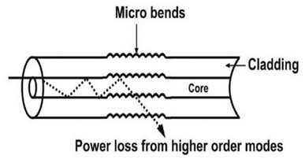
Fiber alignment and joint loss
Radiative Loss
Macroscopic Fiber Bending Losses: due to greater core radius. Bending in which complete fiber undergoes bends which causes certain modes not to be reflected and therefore causes loss to the cladding.
Microscopic Fiber Bending Losses or Mode Coupling Losses: Bending Either the core or cladding undergoes slight bends at its surface. It causes light to be reflected at angles when there is no further reflection

Slide 5
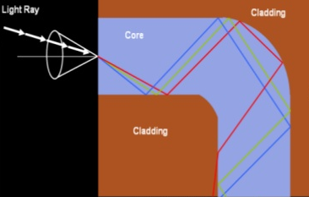
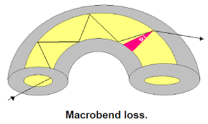
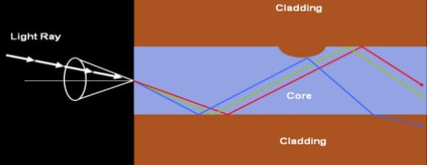
Fiber alignment and joint loss

Slide 6
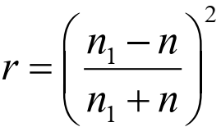
Fiber alignment and joint loss
Optical power loss at the joint is the main concern
Loss due to Fresnel reflection:
Fresnel reflection loss is related to step changes in refractive index at the jointed interface.
Even when two jointed fiber ends are smooth and perpendicular to fiber axis and two fiber axes are perfectly aligned, A small portion of light reflects back into the transmitting fiber
The amount of this partial reflection can be estimated by using classical Fresnel formula:
r is the fraction of light reflected at a single interface n1 is the core refractive index n is refractive index of the medium between two Jointed fibers, say for air n =1

Slide 7

Fiber alignment and joint loss
The loss due to Fresnel reflection at a single interface
The effect of Fresnel reflection at a fiber-fiber connection can be reduced by using an index-matching fluid between the gaps
For consideration of symmetry or same magnitude , the optical loss at first and at second interface always same. Total loss will be the addition of first and second interface
Example: An optical fiber has a core refractive index of 1.5. Two lengths of the fiber with smooth and perpendicular (to the core axes) end faces are butted together. Assuming the fiber axes are perfectly aligned, calculate the optical loss in decibels at the joint (due to Fresnel reflection) when there is a small air gap between the fiber end faces.

Slide 8
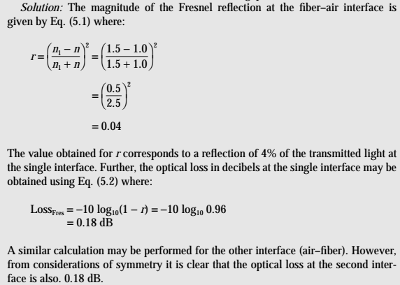
Fiber alignment and joint loss

Slide 9
Fiber alignment and joint loss
Loss due to deviations in the geometrical and optical parameters of the two jointed fibers.
The problems may occur for
Different core and/or cladding diameters;
Different NA and/or relative refractive index differences;
Different refractive index profiles;
Fiber faults: core ellipticity, core concentricity etc
The losses caused by the above factors together with those of Fresnel reflection are usually referred to as intrinsic joint losses.
Use same fibers to keep this loss minimum

Slide 10
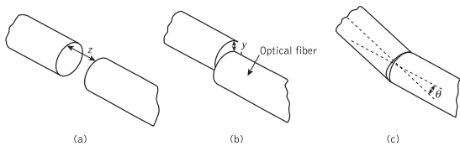
Fiber alignment and joint loss
Loss due to misalignmen :
A major source of loss at a fiber-fiber connection is caused by misalignment of two jointed fibers
Misalignment may occur in three dimensions
Longitudinal misalignment: the separation between the fibers
Lateral misalignment: the offset perpendicular to the fiber core axes
Angular misalignment : the angle between the core axes
Optical losses resulting from these three types of misalignment depend upon the fiber type, core diameter and the distribution of the optical power between the propagating modes

Slide 11

Fiber alignment and joint loss
Multimode fiber joints :
Lateral misalignment reduces the overlap region between the two fiber cores.
Uniform excitation of all optical modes in a multimode step index fiber, the overlapped area between both fiber cores approximately gives the lateral coupling efficiency ηlat.
May be written as
y is lateral offset of the fiber core axes, and a is fiber core radius.
Lateral misalignment loss in decibels may be determined using:

Slide 12
Fiber alignment and joint loss
A step index fiber has a core refractive index of 1.5 and a core diameter of 50 μm. The fiber is jointed with a lateral misalignment between the core axes of 5 μm. Estimate the insertion loss at the joint due to the lateral misalignment assuming a uniform distribution of power between all guided modes when:
(a) there is a small air gap at the joint; (b) the joint is considered index matched.

Slide 13
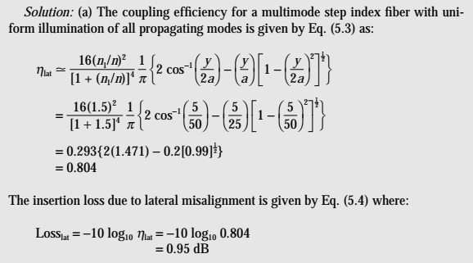
Fiber alignment and joint loss

Slide 14
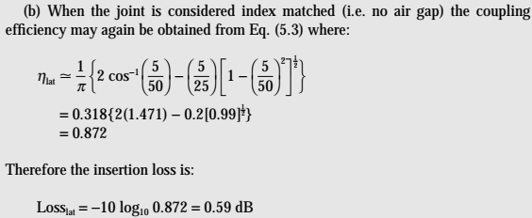
Fiber alignment and joint loss
With index matching, the insertion loss at the joint in Example 5.2 is reduced to approximately 0.36 dB.

Slide 15


Fiber alignment and joint loss
CCE- 323 ( Optical Fiber Communication )
Alternate Lateral misalignment loss in multimode graded index fibers assuming a uniform distribution of optical power throughout all guided modes was calculated by Gloge
lateral misalignment loss was dependent on the refractive index gradient α =2,
where the lateral coupling efficiency was given by:
Lateral misalignment loss in decibels may be determined using:

Slide 16
Fiber alignment and joint loss
CCE- 323 ( Optical Fiber Communication )
Lateral misalignment loss given for the cases of guided plus leaky modes 0.75(y/a) to graded index fiber (where α = 2).
The lateral misalignment losses of 0.64(y/a) and 0.5(y/a) for the cases of guided modes only and both guided plus leaky modes respectively to step index fibers (where α = ∞).
Example 5.3
A graded index fiber has a parabolic refractive index profile
(α = 2) and a core diameter of 50 μm. Estimate the insertion loss due to a 3 μm lateral misalignment at a fiber joint when there is index matching and assuming: (a) there is uniform illumination of all guided modes only; (b) there is uniform illumination of all guided and leaky modes.

Slide 17
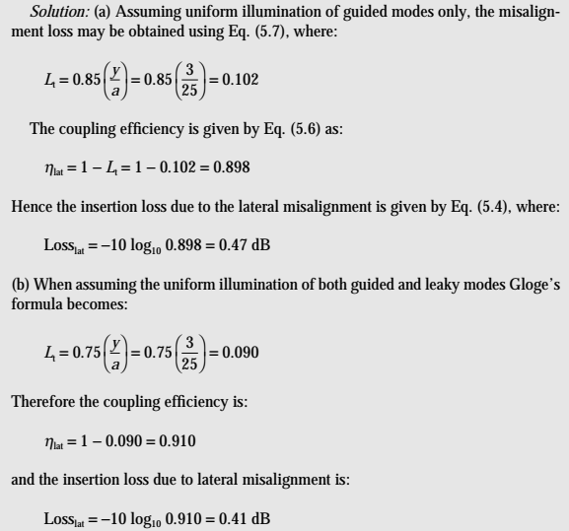
Fiber alignment and joint loss

Slide 18


Fiber alignment and joint loss
Angular misalignment losses at joints in multimode step index fibers may be predicted with reasonable accuracy using an expression for the angular coupling efficiency
where θ is the angular displacement in radians and Δ is the relative
refractive index difference for the fiber.
The insertion loss due to angular misalignment may be obtained from the angular coupling efficiency in the same manner as the lateral misalignment loss following:
Smaller the values of Δ, the larger the insertion loss due to angular misalignment.

Slide 19
Fiber alignment and joint loss
Example 5.4:
Two multimode step index fibers have numerical apertures of 0.2 and 0.4, respectively, and both have the same core refractive index of 1.48.
Estimate the insertion loss at a joint in each fiber caused by a 5° angular misalignment of the fiber core axes. It may be assumed that the medium between the fibers is air.

Slide 20
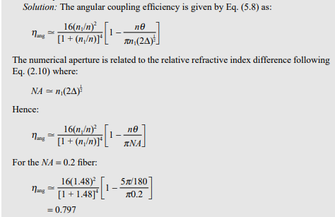
Fiber alignment and joint loss

Slide 21
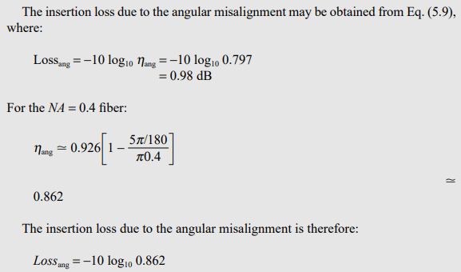
Fiber alignment and joint loss

Slide 22
Fiber splices
Permanent and semi permanent joint between two optical fibers
Fusion splices
Mechanical splices
Precision tube slice
Loose tube splice
V groove splices
Precision pin splice
Multiple splices

Slide 23
Fiber splices
Permanent and semi permanent joint between two optical fibers
Fusion splices: involves the heating of the two prepared fiber ends to their fusing point with the application of sufficient axial pressure between the two optical fibers.
The stripped (of cabling and buffer coating) fiber ends are adequately positioned and aligned in order to achieve good continuity of the transmission medium at the junction point
fibers are usually positioned and clamped with the aid of an inspection microscope
Heating source is an electric arc.

Slide 24
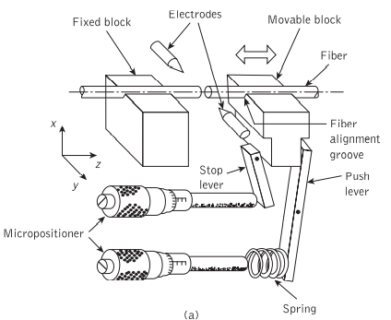
Fiber splices Fusion splices
(a) an example of fusion splicing apparatus

Slide 25
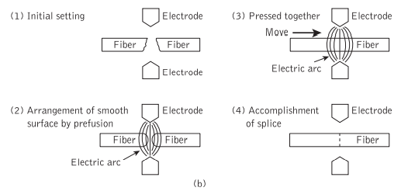
Fiber splices Fusion splices
(b) schematic illustration of the prefusion method for accurately splicing optical fibers

Slide 26
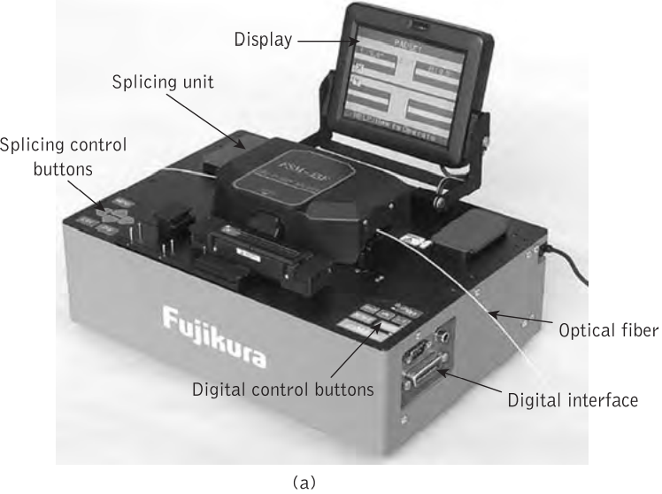
Fiber splices Fusion splices
Fujikura optical fiber fusion splicers: (a) tabletop model

Slide 27
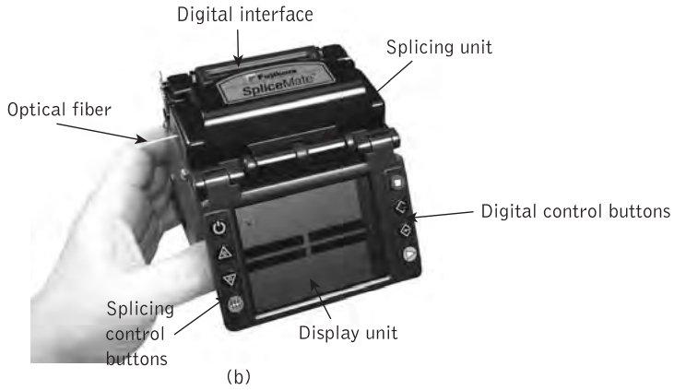
Fiber splices Fusion splices
(b) handheld device

Slide 28
Fiber splices
The use of an accurately produced rigid alignment tube into which the prepared fiber ends are permanently bonded
Mechanical splices: utilize a glass or ceramic capillary with an inner diameter just large enough to accept the optical fibers
Transparent adhesive (e.g. epoxy resin) is injected to give mechanical sealing and index matching of the splice.
loose tube splice uses an oversized square-section metal tube
The splice is self-aligning when the fibers are curved in the same plane, forcing the fiber ends simultaneously into the same corner of the tube

Slide 29
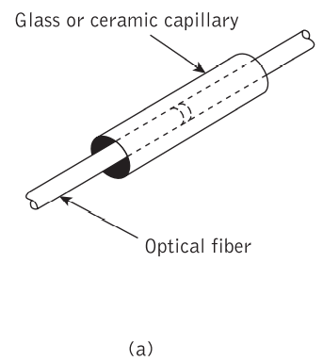
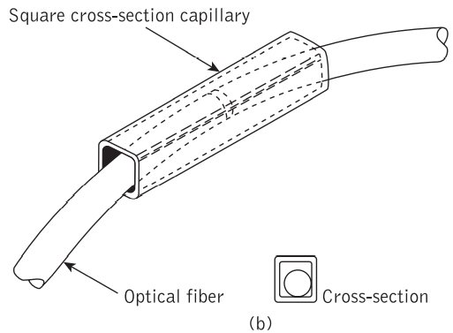
Fiber splices Mechanical splices
Techniques for tube splicing of optical fibers: (a) snug tube splice.
(b) loose tube splice utilizing square cross-section capillary

Slide 30
Fiber splices Mechanical splices
Mechanical splicing techniques involve the use of grooves to secure the fibers to be jointed
utilizes a V-groove into which the two prepared fiber ends are pressed(a)
The splice is made permanent by securing the fibers in the V-groove with epoxy resin
V-groove splices formed by sandwiching the butted fiber ends between a V-groove glass substrate and a flat glass retainer plate(b)
reservations are expressed regarding the field implementation of these splices with respect to manufactured fiber geometry, and housing of the splice in order to avoid additional losses due to local fiber bending.
V-groove technique is the elastic tube or elastomeric splice
An outer sleeve holds the two elastic parts in compression to ensure alignment of the fibers in the V-groove, and fibers with different diameters tend to be centered

Slide 31
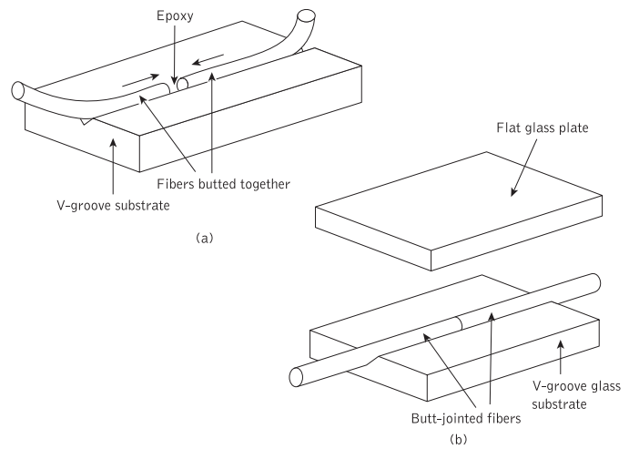
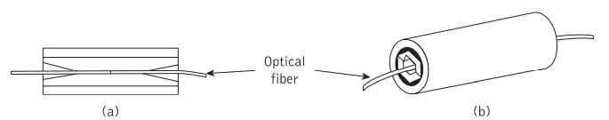
Fiber splices Mechanical splices
V-groove splices
Figure 5.9 V-groove splices
Figure 5.10 The elastomeric splice

Slide 32
Fiber splices Multiple splices
Multiple simultaneous fusion splicing of an array of fibers in a ribbon cable has been demonstrated for both multimode and single-mode fibers
a 12-fiber ribbon was prepared by scoring and breaking prior to pressing the fiber ends onto a contact plate to avoid difficulties with varying gaps between the fibers to be fused
a device is now commercially available to allow the splicing of 12 fibers simultaneously in a time of around 6 minutes, which requires only 30 seconds per splice
V-groove multiple-splice secondary element comprising etched silicon chips
In this technique a 12-fiber splice is prepared by stripping the ribbon and coating material from the fibers. Then the 12 fibers are laid into the trapezoidal* grooves of a silicon chip using a comb structure

Slide 33
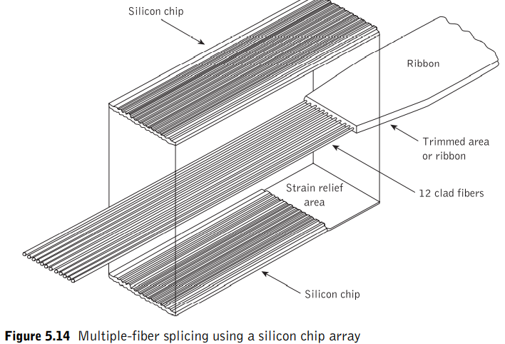
Fiber splices Multiple splices

Slide 34
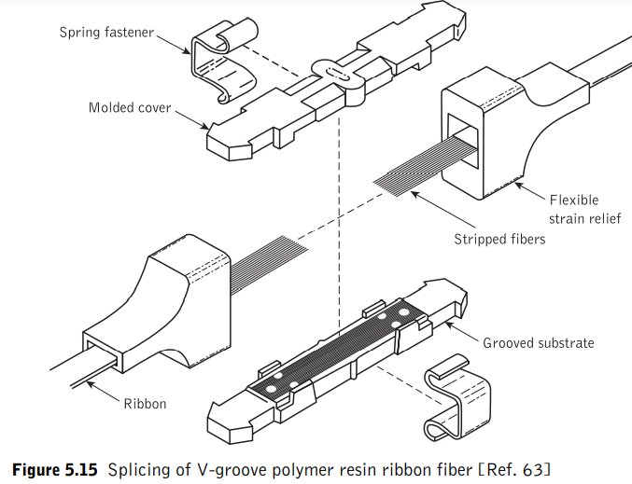
Fiber splices Multiple splices

Slide 35
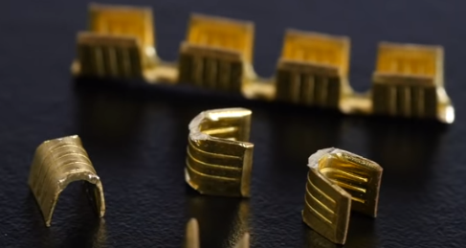
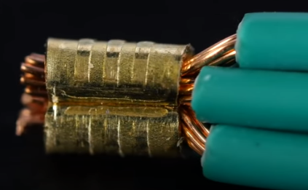
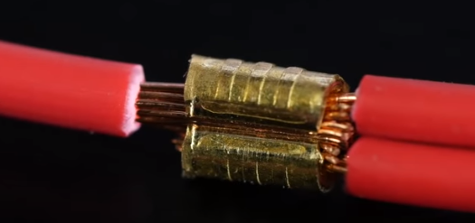
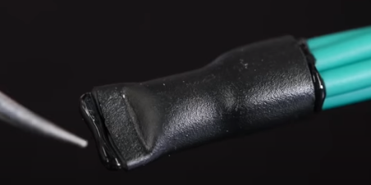

Slide 36
Fiber Connectors
Cylindrical ferrule connectors
Duplex and multiple-fiber connectors
Fiber connector-type summary
optical fiber connectors may be considered in three major areas
(a) the fiber termination, which protects and locates the fiber ends;
(b) the fiber end alignment to provide optimum optical coupling;
(c) the outer shell, which maintains the connection and the fiber alignment, protects the fiber ends from the environment and provides adequate strength at the joint.

Slide 37
Fiber Connectors Cylindrical ferrule connectors
The two fibers to be connected are permanently bonded (with epoxy resin) in metal plugs known as ferrules which have an accurately drilled central hole in their end faces where the stripped (of buffer coating) fiber is located.
Within the connector the two ferrules are placed in an alignment sleeve which, using accurately machined components, allows the fiber ends to be butt jointed.
The ferrules are held in place via a retaining spring
fiber end faces are smooth and square which may be achieved with varying success by:
(a) cleaving the fiber before insertion into the ferrule;
(b) inserting and bonding before cleaving the fiber close to the ferrule end face;
(c) using either (a) or (b) and polishing the fiber end face until it is flush with the end of the ferrule.

Slide 38
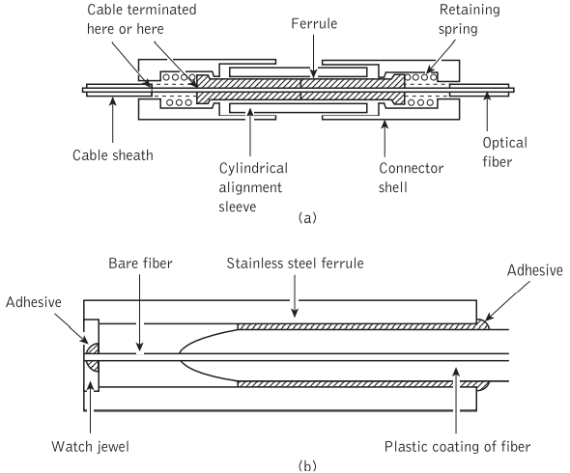
Fiber Connectors Cylindrical ferrule connectors

Slide 39
Fiber Connectors Cylindrical ferrule connectors
Some ferrule connectors have incorporated a watch jewel in the ferrule end face in order to have fiber alignment accuracy
In this case the fiber is centered with respect to the ferrule through the watch jewel hole.
The use of watch jewel allows close diameter and tolerance requirements of the ferrule end face hole to be obtained more easily than simply through drilling of metallic ferrule end face alone.

Slide 40
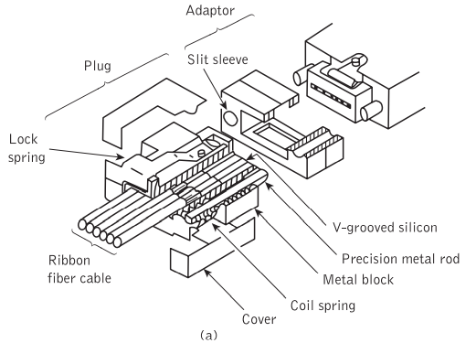
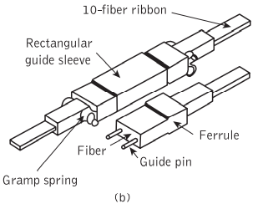
Fiber Connectors Duplex and multiple-fiber connectors
A number of duplex fiber connector designs were developed in order to provide two-way communication
AT&T produced a duplex version of the ST single-fiber connector

Slide 41
Fiber Connectors Duplex and multiple-fiber connectors
the force needed to insert multiple cylindrical ferrules can be large
In this case multiple biconical ferrule connectors prove advantageous due to the low insertion force of the biconic configuration.
Silicon chip arrays were suggested for the jointing of fiber ribbon cable for many years and difficulties were experienced
problems were then largely overcome by the multiple-connector design shown in priviouse Figure 5.19(a)
The fiber connections were then accomplished by butt jointing the two pairs of guiding rods in the slitted sleeves located in the adaptor, also illustrated in Figure 5.19(b).

Slide 42
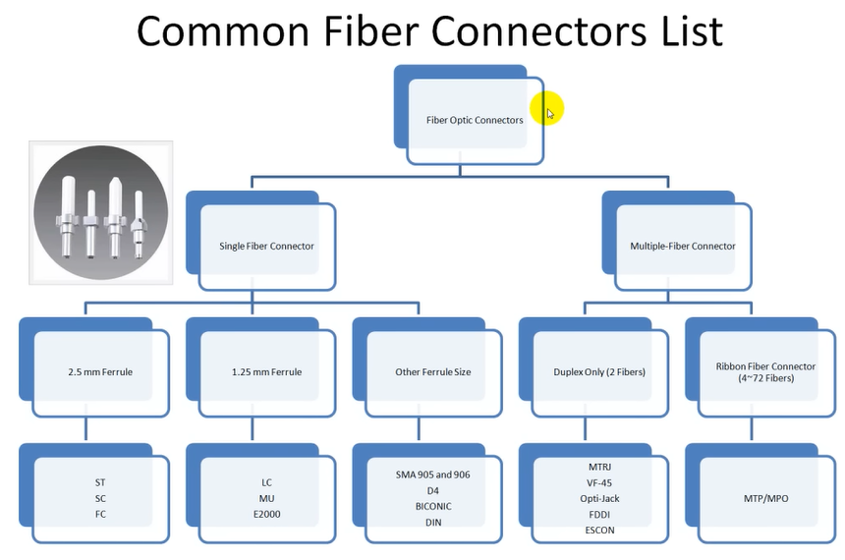

Slide 43
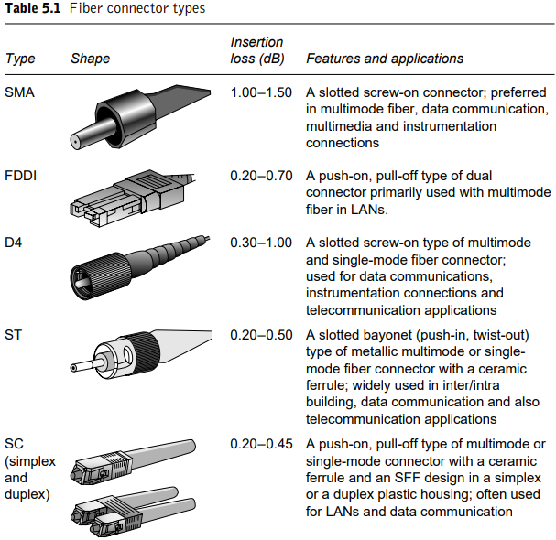
Fiber Connectors Fiber connector-type summary

Slide 44
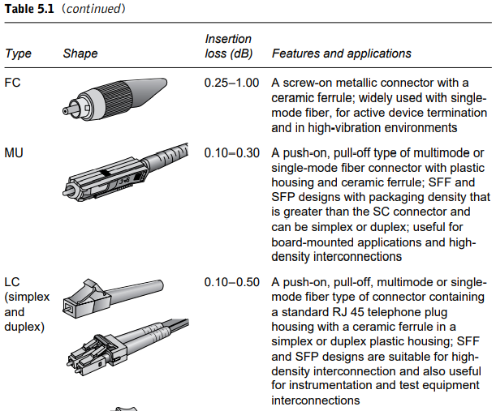
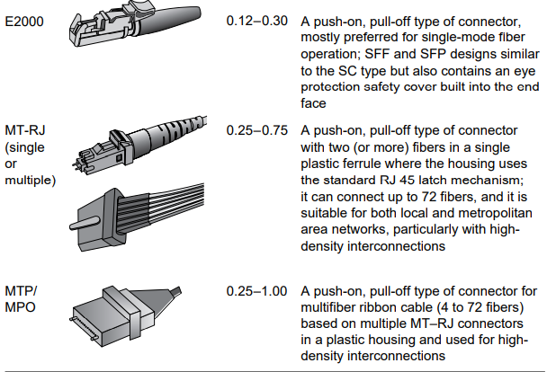
Fiber Connectors Fiber connector-type summary

Slide 45
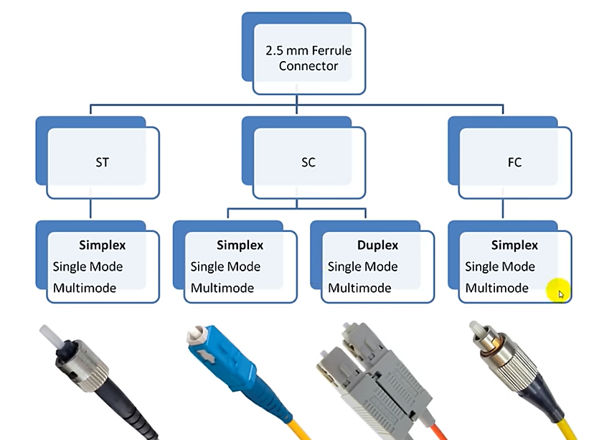

Slide 46
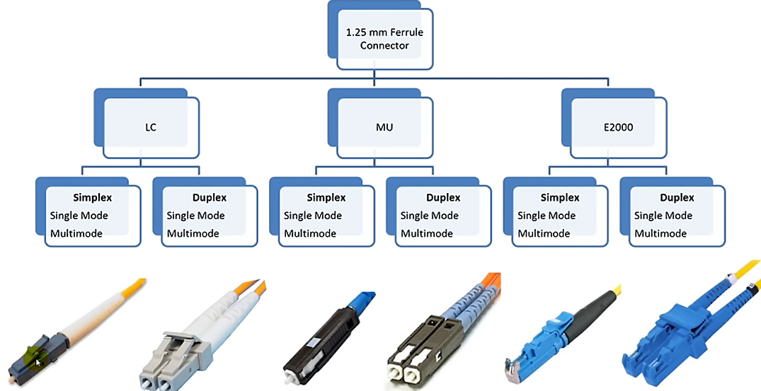

Slide 47
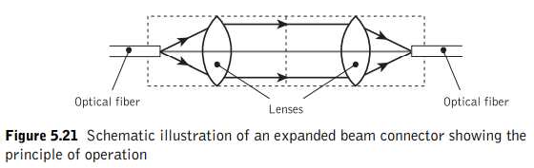
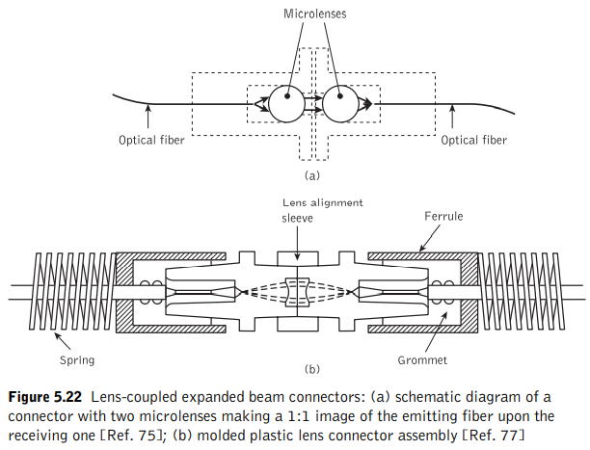
Fiber Connectors Expanded beam connectors

Slide 48
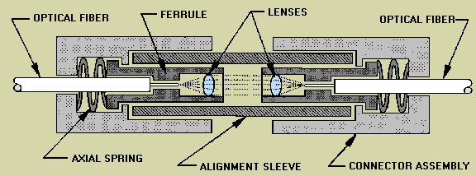
Fiber Connectors Expanded beam connectors
An alternative to connection via direct butt joints between optical fibers is offered by the principle of the expanded beam
a connector consisting of two lenses for collimating and refocusing the light from one fiber into the other.
The use of these interposed optics makes the achievement of lateral alignment much less critical than with a butt-jointed fiber connector.

Slide 49
Fiber couplers
Fiber Couplers are branching devices that split all the light from a main fiber into two or more fibers
Alternately couple a proportion of light propagating in the main fiber into a branch fiber
they can combine light from two or more branch fibers into a main fiber
Optical fiber couplers are passive devices in which power transfer takes place in two ways:
(i) Core-interaction type: through fiber core cross-section by butt jointing the fibers
(ii) Surface-interaction type: through fiber surface and normal to its axis by converting the guided core modes to both cladding and refracted modes

Slide 50
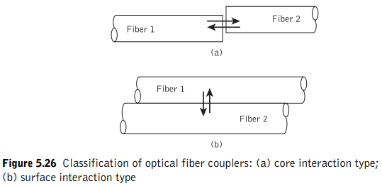
Fiber couplers

Slide 51

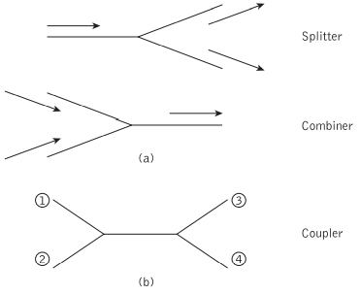
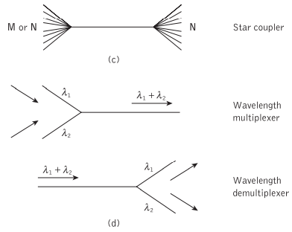
Fiber couplers Optical Fiber Coupler Types

Slide 52
Fiber couplers Functions of Multiport Couplers
1. Three- (a) and four-port* (b) couplers, which are used for signal splitting, distribution and combining.
2. Star couplers (c), which are generally used for distributing a single input signal to multiple outputs.
3. Wavelength division multiplexing (WDM) devices, which are a specialized form of coupler designed to permit a number of different peak wavelength optical signals to be transmitted in parallel on a single fiber (see Section 12.9.4). In this context WDM couplers either combine the different wavelength optical signal onto the fiber (i.e. multiplex) or separate the different wavelength optical signals output from the fiber (i.e. demultiplex).

Slide 53
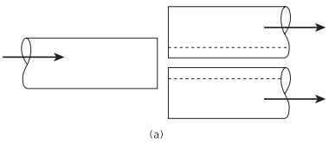
Fiber couplers Three- and four-port couplers
(a) Lateral Offset Method:
-Fiber end faces are overlapped, Light from input fiber is coupled to output fibers according to degree of overlap.
-Input power can be distributed in a well defined proportion by appropriate control of lateral offset between fibers.
-Suitable for multimode fibers but with high excess loss.

Slide 54
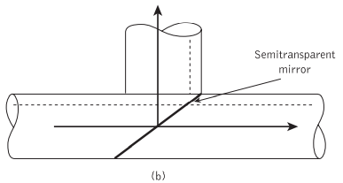
Fiber couplers Three- and four-port couplers
(b) Semitransparent Mirror Method:
-A beam splitter element between the fibers; A partially reflecting surface is placed to the end face cut at an angle 45º to form a thin beam splitter
-The input power may be split in any desired ratio between the reflected and transmitted beams
- Typical excess loss: 1~2 dB, suitable for both MMF and SMF

Slide 55
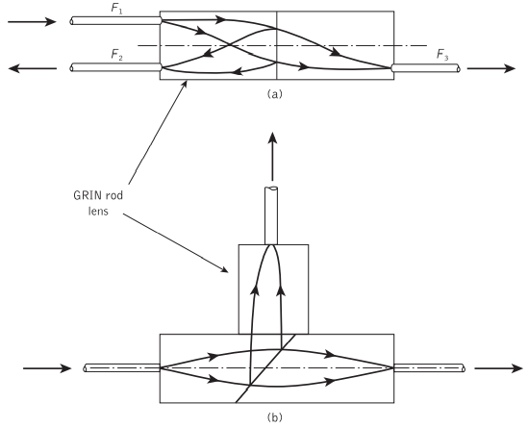
Fiber couplers 3-Port Coupler Based on Micro-optic Components
Figure 5.29(a) shows the structure of a parallel surface type of GRIN-rod lens three port coupler which comprises two quarter pitch lenses with a semitransparent mirror in between.
The slant surface version of the similar coupler is shown in Figure 5.29(b).

Slide 56
Fiber couplers 3-Port Coupler Based on Micro-optic Components
These couplers utilize the beam expansion and collimation properties of graded index (GRIN) rod lens combined with spherical retro-reflecting mirrors (which reflects light back to its source)
It consists of two quarter pitch lenses with a semitransparent mirror in between
Light rays from input fiber F1, collimate in the first lens before incident on mirror. A portion of incident beam is reflected back and is coupled to fiber F2.
The transmitted light is focused in 2nd lens and then coupled to F3.
Parallel surface type is more attractive because of ease of fabrication, compactness, simplicity and relatively low insertion loss
For both, insertion loss <1dB

Slide 57
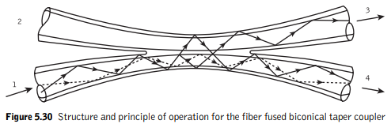
Fused Biconical Taper (FBT) technique
In this method the fibers are generally twisted together and then spot fused under tension such that the fused section is elongated to form a biconical taper structure.

Slide 58



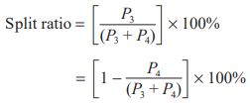
Fiber couplers
The excess loss which is defined as the ratio of power input to power output is given by:
Excess loss (four-port coupler) =
The insertion loss, however, is generally defined as the loss obtained for a particular port to-port optical path.
Insertion loss (ports 1 to 4) =
The crosstalk which provides a measure of the directional isolation† achieved by the device is the ratio of the backscattered power received at the second input port to the input power which may be written as:
Crosstalk (four-port coupler) =
Finally, the splitting or coupling ratio indicates the percentage division of optical power between the output ports.

Slide 59
Fiber couplers
Example 5.7
A four-port multimode fiber FBT coupler has 60 μW optical power launched into port 1. The measured output powers at ports 2, 3 and 4 are 0.004, 26.0 and 27.5 μW respectively. Determine the excess loss, the insertion losses between the input and output ports, the crosstalk and the split ratio for the device.

Slide 60
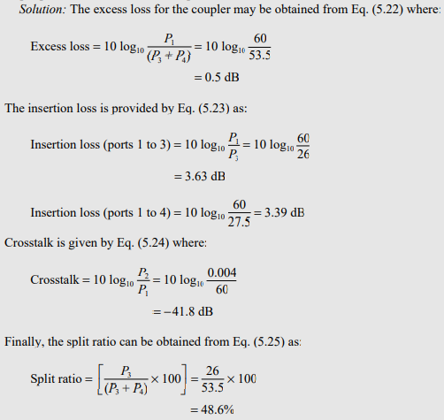
Fiber couplers

Slide 61
THANKS
A picture paints a thousand words

